Slide 1
OTA Update Process Documentation for Writing Team
***NOTE: Some content has been blurred or excluded for portfolio purposes. This document was originally created in Figma, which may have resulted in some image distortion.

Slide 2
Overview
OTA release notes provide customers with insight into what fixes or changes may have been implemented to improve the user experience within their vehicle. The driver will see these release notes prior to installing a software update in their vehicle. The creation and distribution of this content requires collaboration between the team requesting the release notes and the writers on the Interface Design team.
This artifact was created to:
Provide documentation or the OTA update process, with the understanding that this process will undergo continuous improvements.
Provide resources and tools to assist writers in creating OTA updates.
Defining the teams and individual contributors that are essential to the creation of updates that are accurate and suited to the audience.
Contributors:
Xxx xxx, Lead Writer for In Vehicle Content, Interface Design
Emily Piech, Technical Writer, Interface Design
Xxx xxx, Producer, Interface Design Operations
Requestors, VSEs, DREs, Product, Legal, Marketing

Slide 3
General Guidelines
The goal of the OTA update release notes should be to inform the driver of changes that they will notice while using their vehicle after installing the software update. These general guidelines are meant to ensure that the information presented to the driver is clear, accurate, informational, and adherent to legal guidelines.
Include:
Fixes and improvements that may be impactful for the driver.
The system or feature that is affected by each change.
Avoid:
Language or content that could be perceived as sales or marketing related.
Any statements that are misleading or that overstate the fix.
OTA updates that include an excess of content. Large updates may affect the way the content is displayed in the vehicle. The limit should be around 5 or 6 bullet points.

Slide 4
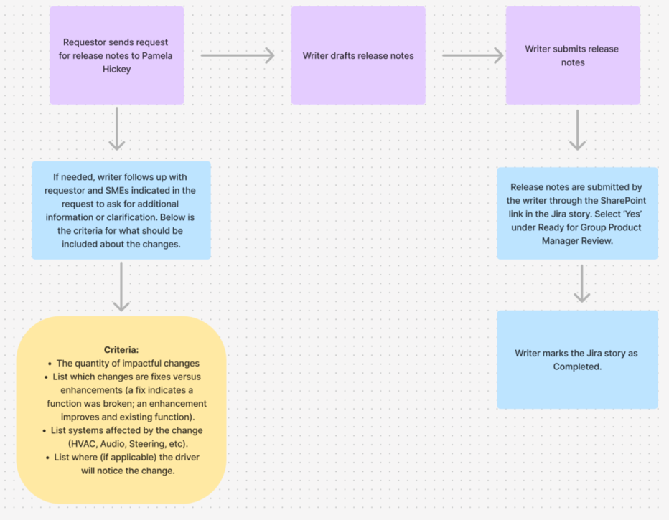
Process Map

Slide 5
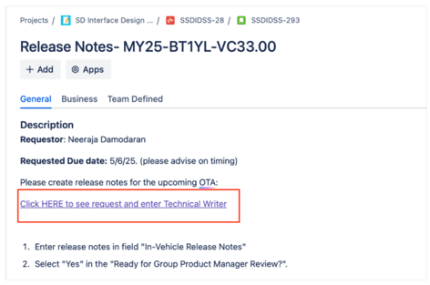
SharePoint Request Form
The SharePoint request form contains the information used to write the OTA update, although for most requests follow-up questions for the engineers will be necessary. The form is also used to submit the content. This form will be linked to the Jira ticket.

Slide 6
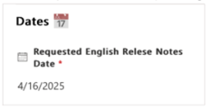
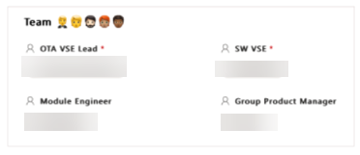
SharePoint Request Form Information
Below are the areas of the OTA update SharePoint page that the writer will use to determine the content for the OTA update, view the contacts / stakeholders, and submit the content.
The date that the release notes are due is seen here. If this date is not reasonable for the size of the update of the difficulty level of interpreting the input, request through Pam that the date be moved.
Under Team are the contacts for the release. If any follow-up questions are needed, include the people listed in this section in your email.

Slide 7
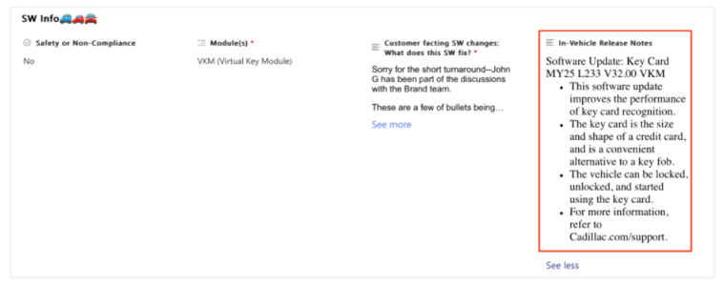
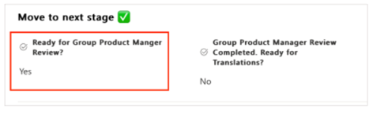
SharePoint Request Form to Submit
Below are the areas of the OTA update SharePoint page that the writer will fill out. When you have completed these, click Save on the upper left corner of the page.
Enter the release notes in the In-Vehicle Release Notes field.
To submit the release notes, select Yes under Ready for Group Product Manager Review.

Slide 8
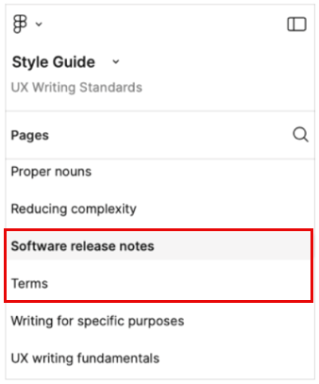
Systems and Resources
Style Guide:
The Style Guide should be referenced to ensure the language used in OTA updates in consistent with other Interface Design content. The software release notes section provides guidance on format and nomenclature for release notes. The terms section can also be helpful when determining the appropriate customer term for certain features or systems.
**Link was here, excluded for portfolio purposes.

Slide 9
Systems and Resources

Slide 10
Systems and Resources

Slide 11
Recall / Safety / Non-Compliance

Slide 12
Enhanced OTA Updates

